Slide 1
Dog vs Cat CNN Classifier
Bolei Chen Yilin Hou Yitong Zhou

Slide 2
Procedure
Data preparation
Model training
Graphical user interface
Result
Conclusion

Slide 3
Data preparation
Cat and dog dataset
For information see
http://research.microsoft.com/en-us/projects/asirra/corpus.aspx

Slide 4
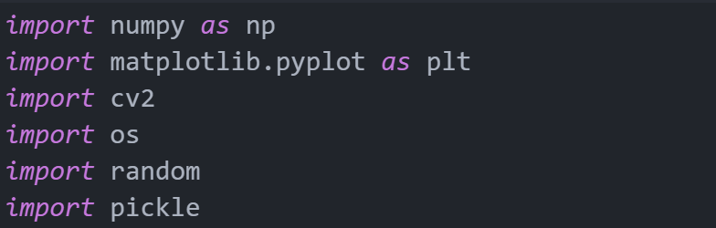
Data preparation
Packages
Get path

Slide 5
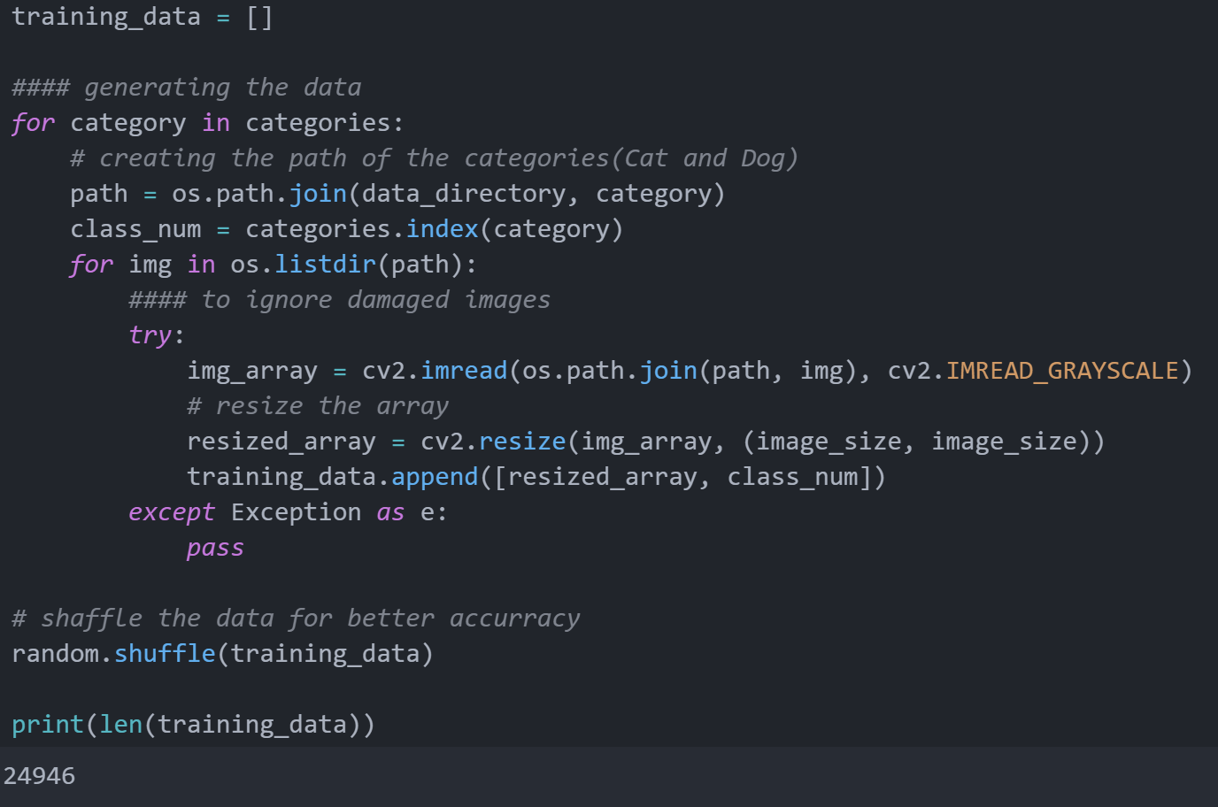
Data preparation
Converting images to arrays

Slide 6
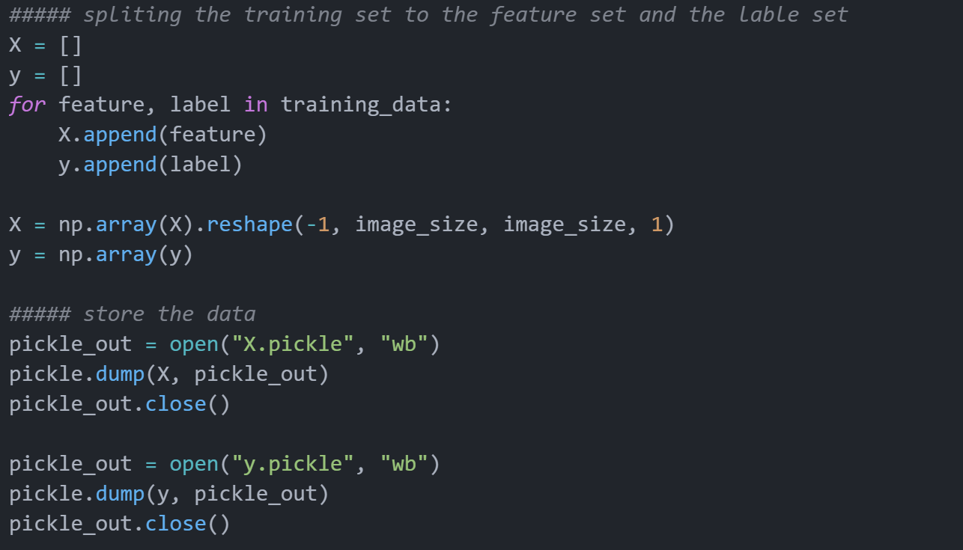
Data preparation
Store the data

Slide 7
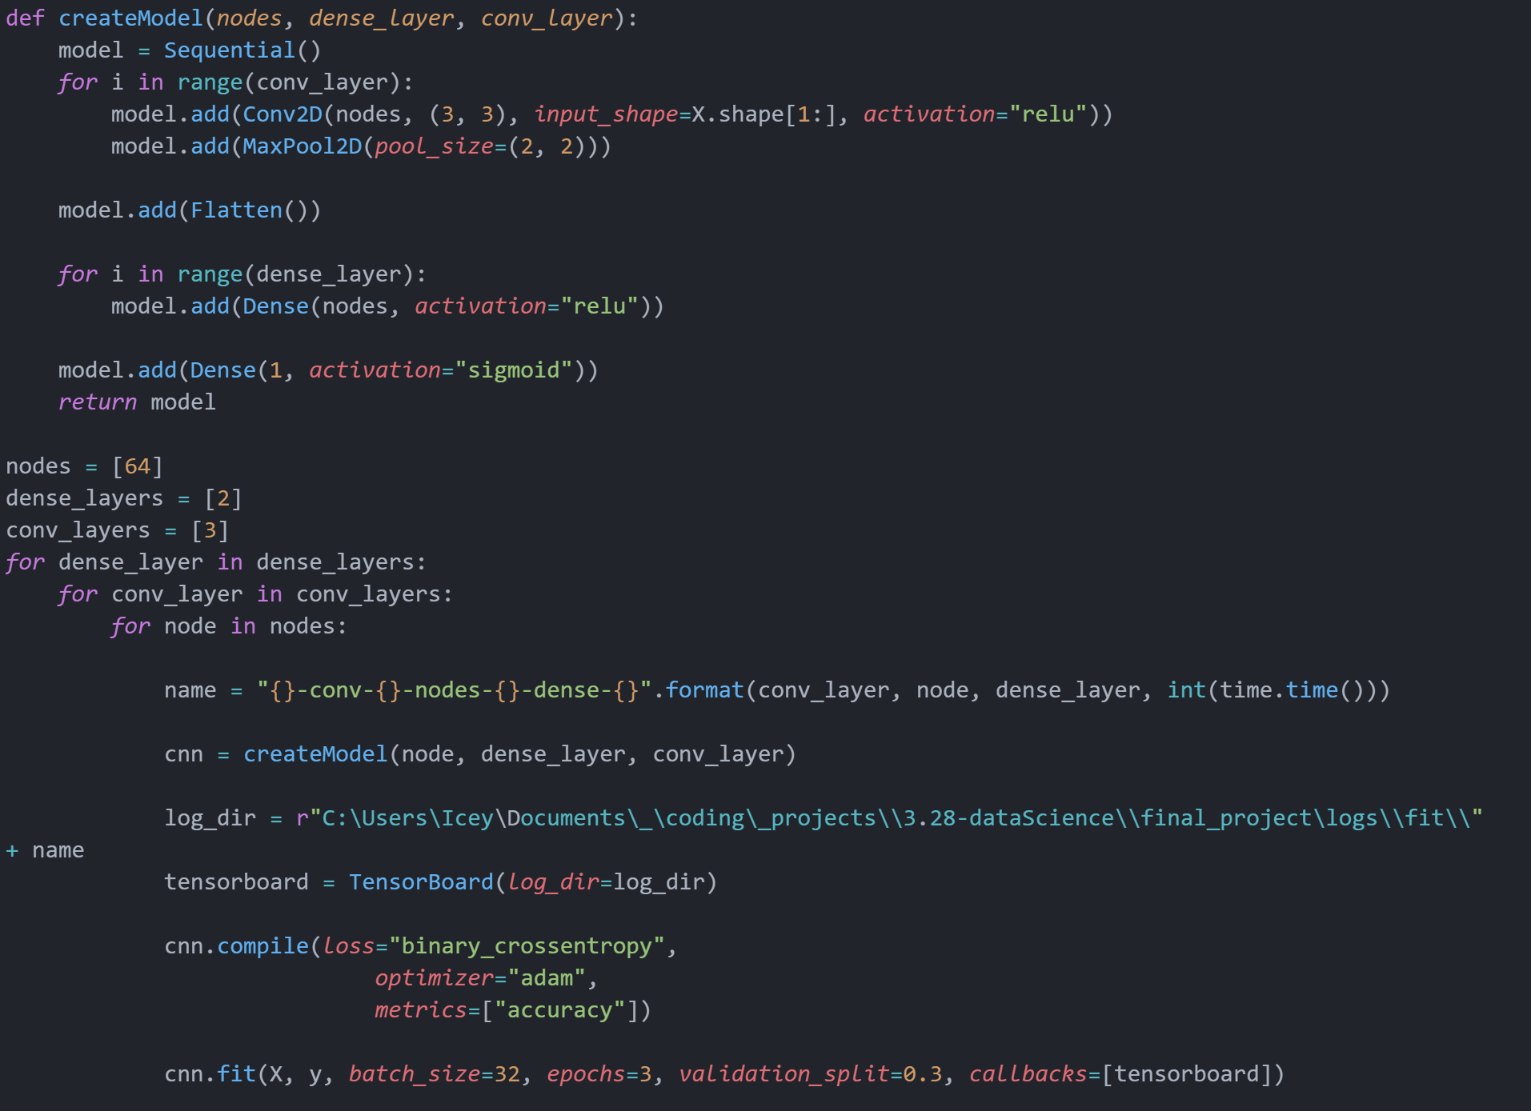
Model training

Slide 8
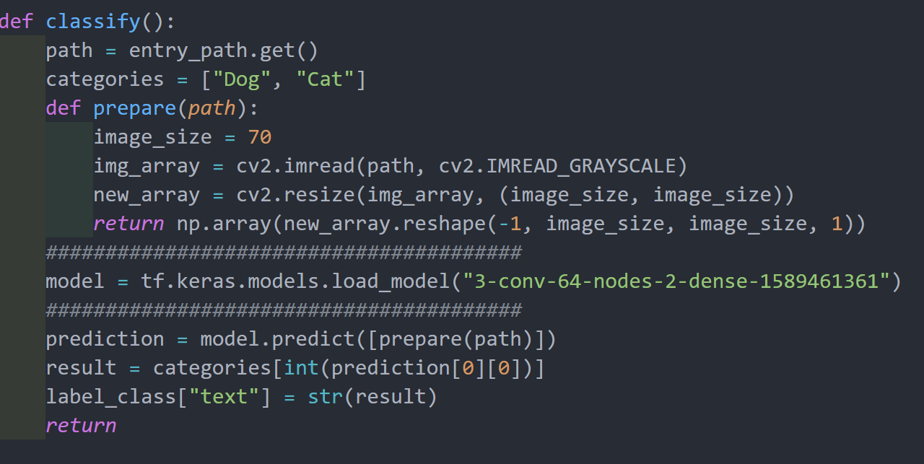
Graphical User Interface

Slide 9
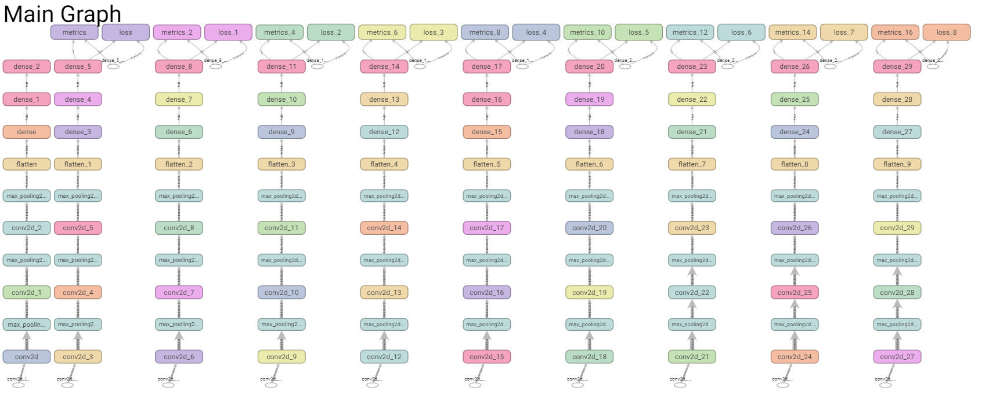
Result

Slide 10
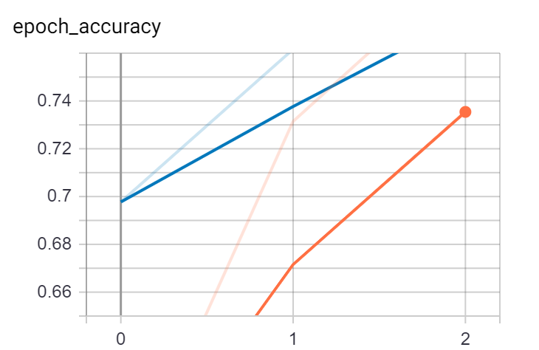
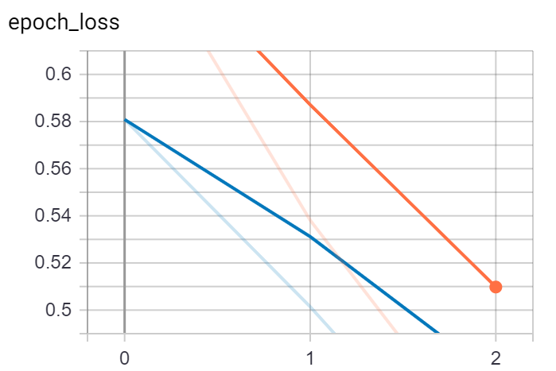
Result

Slide 11
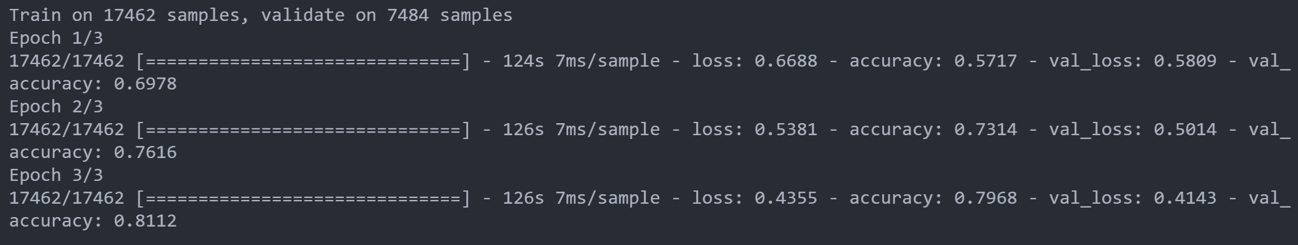
Result

Slide 12
Conclusion

Slide 13
Thanks for listening

